Slide 1
The Missing dots - Between theory and practice – Action Research Project Raisa Kabir

Slide 2
Academics with chronic illness, disabilities or neurodiversity are practically unseen and starkly under-represented in comparison to students with disabilities or disabled people in the general public (Brown and Leigh 2018).

Slide 3
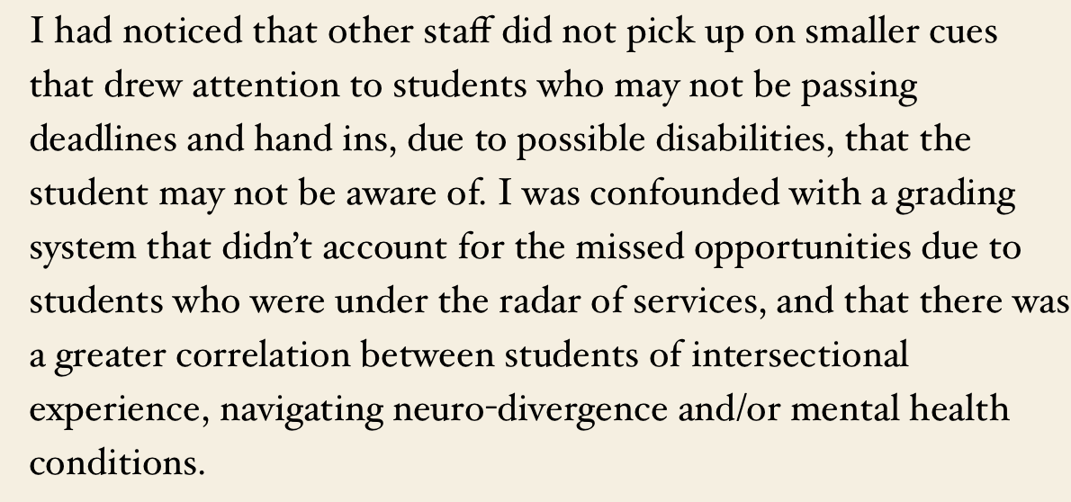
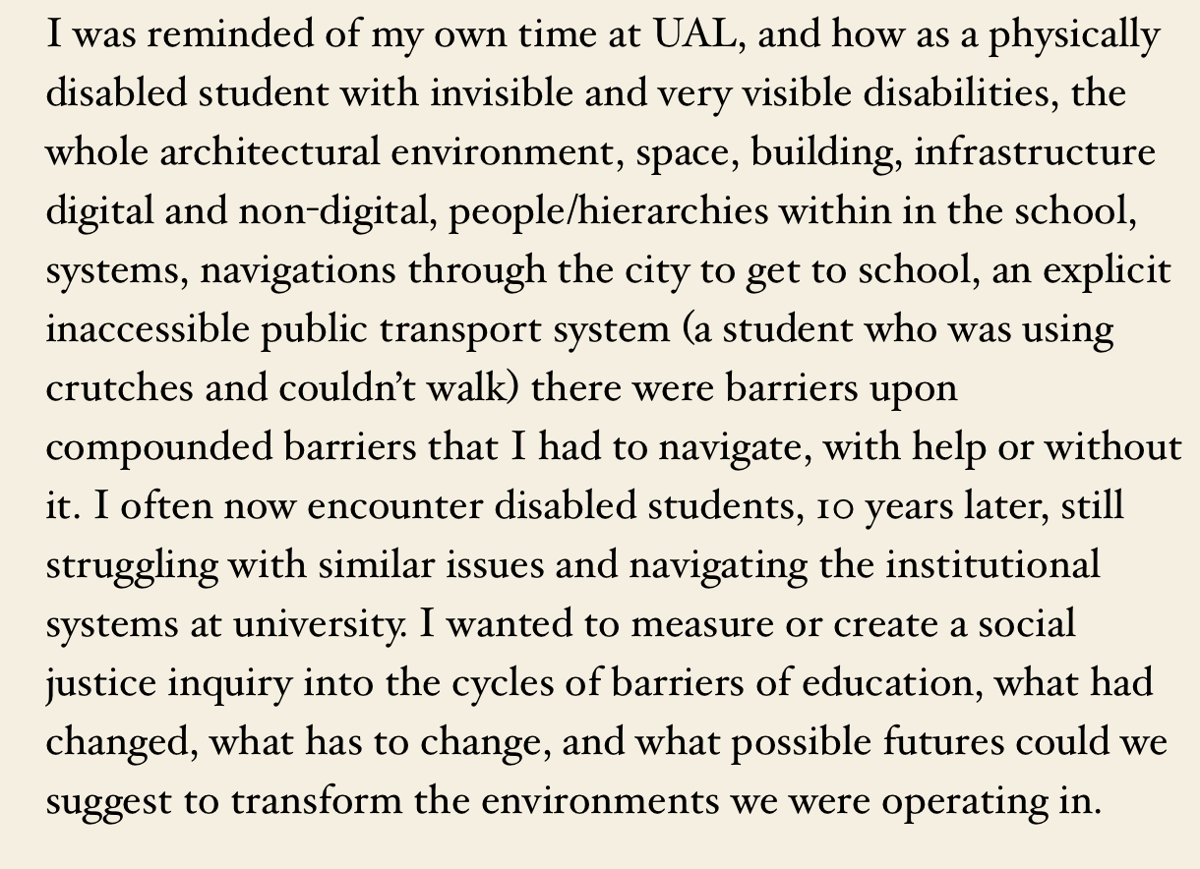
Positionality as researcher
Experience of being a Disabled student and staff (multiple physical disabilities)
South Asian/Bangladeshi immigrant history
Multiple experience of navigating health care systems, racism, institutional ableism, section 28,
Access to education, Mum a social justice activist with post graduate education

Slide 4
Research methods
- Small number of case studies
Qualitive interviews/conversations with fixed questions using audio recordings
The data to feedback into focus groups and participatory workshops with educators
These findings to be put into practice in the teaching environment. Test, observe, record findings.

Slide 5
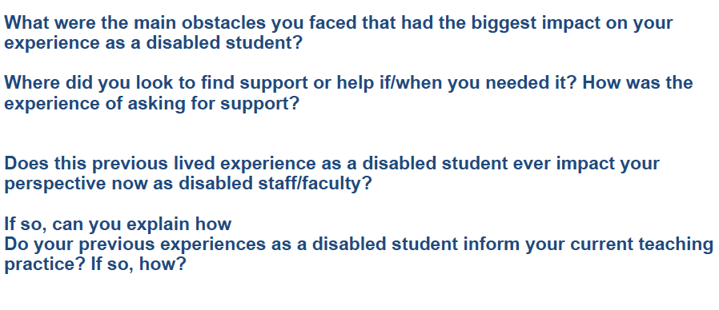

Slide 6
Obstacles for current students -
1)Often students often didn’t know they were struggling with a possible disability
2) Barriers such as diagnosis and medical model to receive support
3)There is shame/Internalised ableism in asking for help and support, and even when offered, many students do not take it, it is seen as a negative.
4) This shame is reinforced by the institution, and the systems that operate within higher education that are inherently ableist in the first place. Students fall at these hurdles, then it initiates a spiral of self doubt, less likely to ask for support, and shame around asking for support, and reinforces the internalization that they are ‘less able’ to participate at university and less able to meet the demands of the course compared to their peers.
5)Again the cycle continues. Of shame, and internalization that the issue is themselves, and not the structures of ableism that prevent the student from delivering or participating at university.

Slide 7
Student encounters barriers/hurdle
Feels shame/ableism that they are not able to participate, complete the task or project in same structure as others
Doesn’t perform as well at task/or project, slips behind - this reinforces it is their own lacking
Internalises shame and ableism, that there is a deficiency that they are not good enough, attends less of their education. Self doubt.
Declines help because of shame/internalisation OR is unable to find help because they do not know
Less likely to seek support, because of ableism/admitting they need help. There is shame is asking for help, shame in being disabled.
Internalised Ableism spiral

Slide 8
Disabled staff embed regular access logistics into their teaching, and access intimacy
“I’ll just try to make it as accessible as possible, I will ask about access requirements, I will try to diversify my curriculum and methods, have shorter sessions, make sure there are regular breaks in lessons, have a range of media and materials and not just readings. Make sure I’m in a room that is wheelchair accessible, check that the lift hasn’t broken down"
But to change conditions of access, should not only be about technical access but about Liberatory access models, that tackle the shame/ Internalised Ableism associated with access needs or disclosing being a disabled student, but to create Liberatory access that ensures everyone has the tools to participate
There are greater shifts in curriculum work, offering the possibility for students to discuss their disability and modulating the class room format/crits to make it more accessible
– but Staff do not want to feel like its only up to them to counter ableism in university, it doesn’t work if only a small number of lecturers are doing this kind of work, and “felt but no matter what we do, at the end of the day we are stuck in a system where the university is inherently colonial, hierarchal, where the students pay fees, they are in debt, they are “customers”, and we are workers serving them”
“when the system itself is so ableist, the collective conditions do not support individual pedagogy to push against what is already a very punitive and ableist structure."

Slide 9
Observations of student experience –
sometimes it's kind of like a mirror, you can see how someone else is struggling in the same ways just like lack of motivation, lack of interest, lack of like being able to meet deadlines. Yes seeing those things I think that's probably like having that insight from someone who experienced it ( a disability) then it just becomes more obvious when a student is going through that experience.

Slide 10
Institutional ableism
For some, the structural conditions did not support staff to feel able to disclose a disability, amidst fears of being undermined, or perceived as not as professional or not as good at their job – this especially true if the person had interacting multiple marginalised identities, which constituted and compounded the ways institutional ableism operates.

Slide 12
“Access for the sake of access is not necessarily libratory, but access for the sake of connection, justice, community, love and liberation is. We can use access as a tool to transform the broader conditions we live in, to transform the conditions that created that inaccessibility in the first place. Access can be a tool to challenge ableism, ablebodied supremacy, independence and exclusion. I believe we can do access in liberatory ways that aren’t just about inclusion, diversity and equality; but are rather, in service of justice, liberation and interdependence.”
Mia Mingus – 2017 Access Intimacy, Interdependence and Disability Justice
Orienting towards transformation of structures, removing the burden from disabled or social justice aligned staff to only tweak the system, The whole geography of these academic spaces and the art school is highly inaccessible, it is built into the framework.
We can only seek to elevate universal design, understand that interdependence means the access for one person is built in across the board and helps elevate and lift everyone’s experiences of these barriers and the role of access in deepening relationships between students, faculty, administration, and faciliites.
Whilst doing the work of re-evaluating fees, the concept of paying for education, inequal power relations of hierarchy!

